Slide 1
Who Plugged That In?
DISCOVERING WHAT IS ON YOUR NETWORK WITH NMAP AND OTHER OPEN SOURCE TOOLS

Slide 2
MY VIEWS ARE MINE AND DO NOT REPRESENT MY EMPLOYER'S.

Slide 3
I’m not responsible for how you use this information. Use at your own risk. Sorry…..
:’(

Slide 4
TWITTER: @JEREDBARE
EMAIL: JEREDBARE@GMAIL.COM
CELL: 573-355-0676

Slide 5
Who am I?
IT Security Analyst at CarFax
From a small town called Mound City, MO

Slide 6
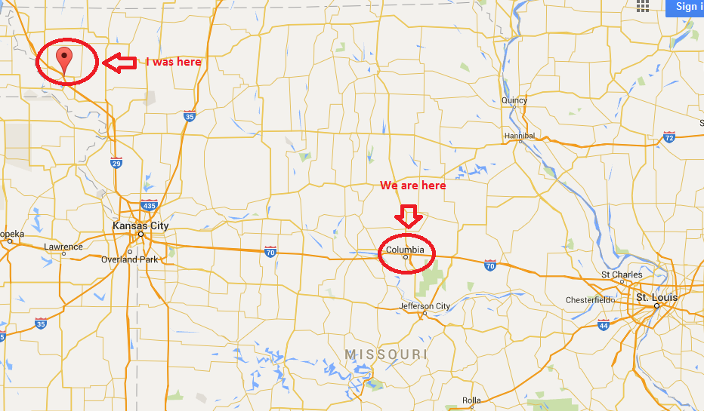

Slide 7
Who am I?
IT Security Analyst for CarFax
From a small town called Mound City, MO.
Currently Live in CoMo, Central MO for six years.
Working in IT for nine years (Tech, Sysadmin, Security).
SANS Courses
505 Securing Windows
504 Hacker Tools, Techniques, and Incident Handling
GCIH Certified
Winning team for SANS 504 CTF
Passion for Information Security.

Slide 8

What exactly is on my network?

Slide 9
Why is this good to know?
Help others secure their networks to prevent them from attacking ours.
Maybe this is or is not your first time working with IT.
Previous employee did not do a good job with IT or Security.
Maybe this talk will get you involved in the community.

Slide 10
How this information can help you
Critical Security Controls 1
Inventory of Authorized and Unauthorized Devices
NIST Core Frameworks
ID.AM-1
ID.AM-3
ID.AM-4
PR.DS-3
How do you know what to protect?
Approved Software?
Dropbox
IoT or IoE
Smart Phones, tablets, thermostats, treadmills, etc.

Slide 11
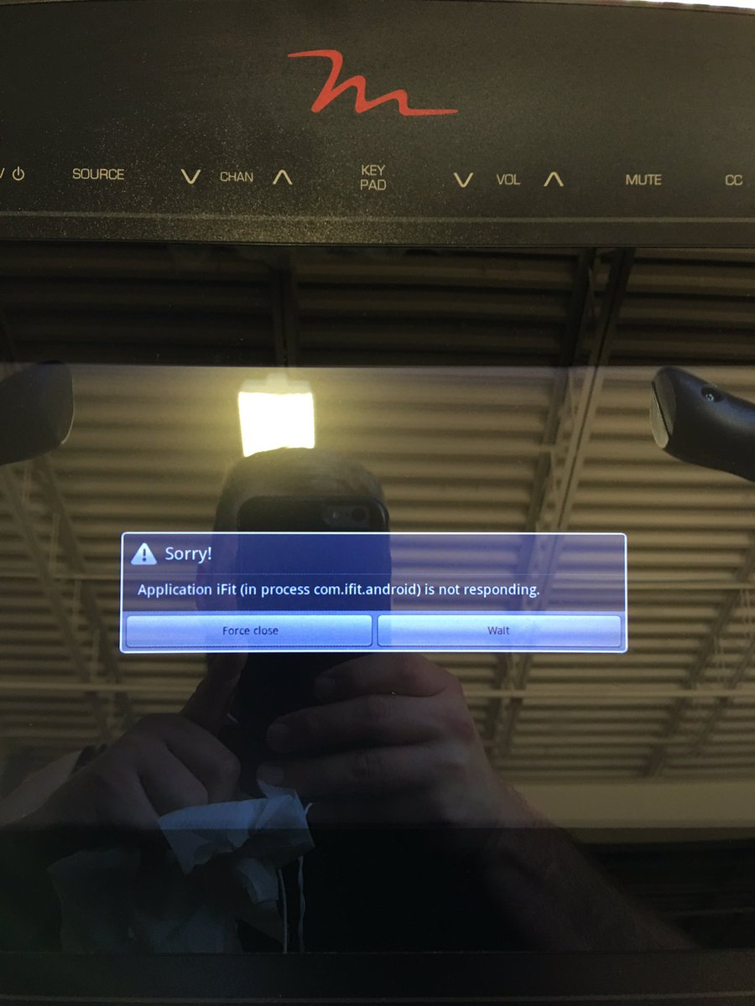

Slide 12

Remember Target?
In 2013 Target was breached and the hackers were able to get access to 110 million people’s credit and debit card information.
HVAC Third Party vendor had a server that had access rights to the network. Failed to segment network.
Home Depot, JP Morgan, Neiman Marcus

Slide 13
One more company…….

Slide 14



Notes:
Equifax! Struts framework

Slide 15
Tools

Slide 16
Open Source Tools
Shodan
Warberry Pi
RainMap
Automation/Scripting
Internal Scanning
Command Line
NMAP
Passive Discovery Scripts
GUI
ZenMap
Sparta (Kali Linux)
Wireshark
External Scanning
Certificate Logging Tools
Cloud Services

Slide 17
Why?
Maximum Visibility
Known knows, know unknowns, unknown unknowns
Open Source
Free!
Software kept up to date
Passionate Community

Slide 18
Command Line Tools
NMAP
Network security scanner for network discovery and security auditing.
Built-in scripting engine to make it more than a port scanner.
Outstanding documentation and examples.
Universal Platform: Windows, Mac OSX, Linux.
nmap.org
Passive Discovery Scripts
Set of scripts by Lee Baird
Scanning, Recon, Automation penetration testing for your network.
Use in Kali Linux. https://github.com/leebaird/discover

Slide 19
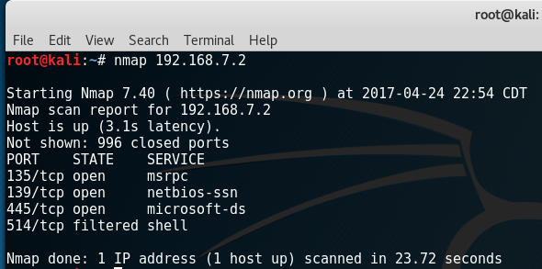
NMAP Scanning an IP and Subnet

Slide 20
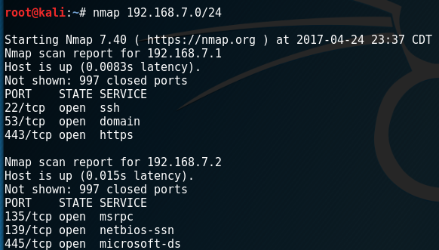

Slide 21
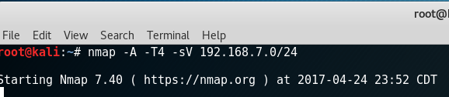
NMAP Scanning a subnet

Slide 22
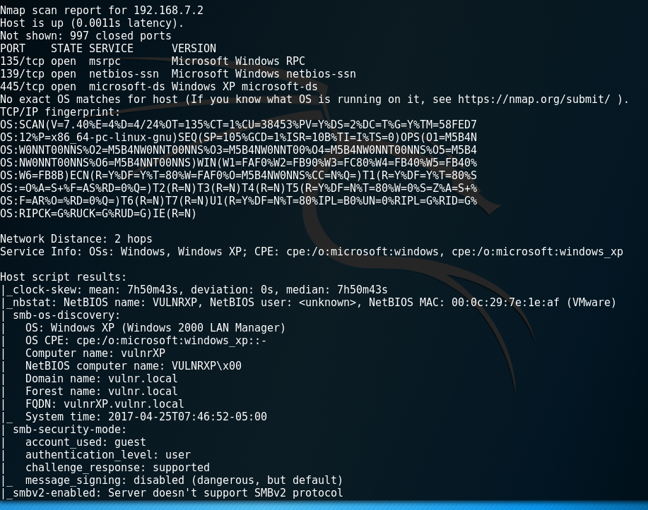

Slide 23
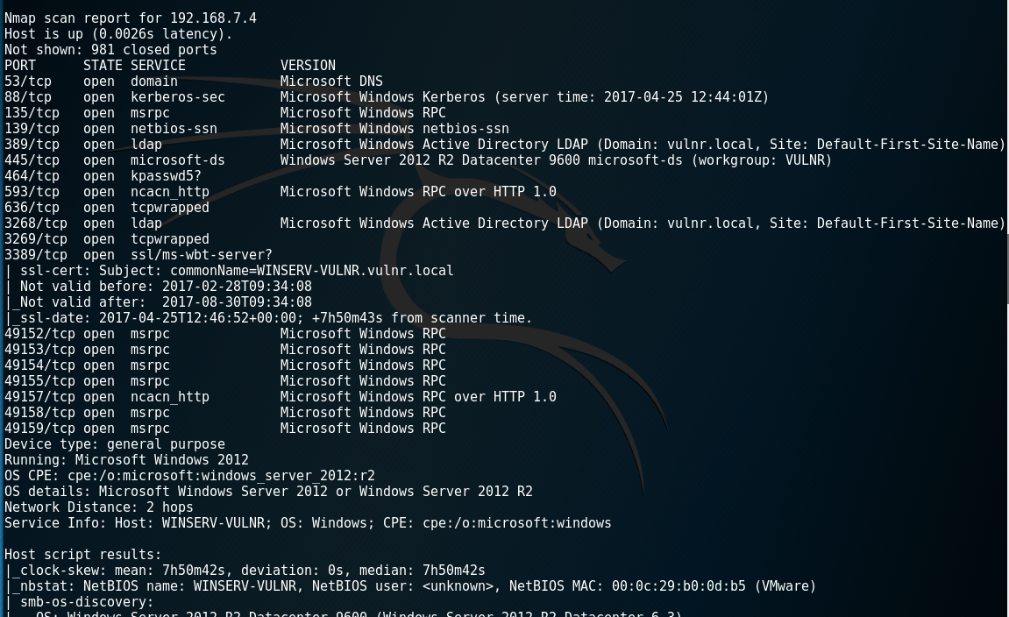

Slide 24
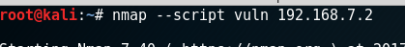
NMAP Scripting Engine

Slide 25
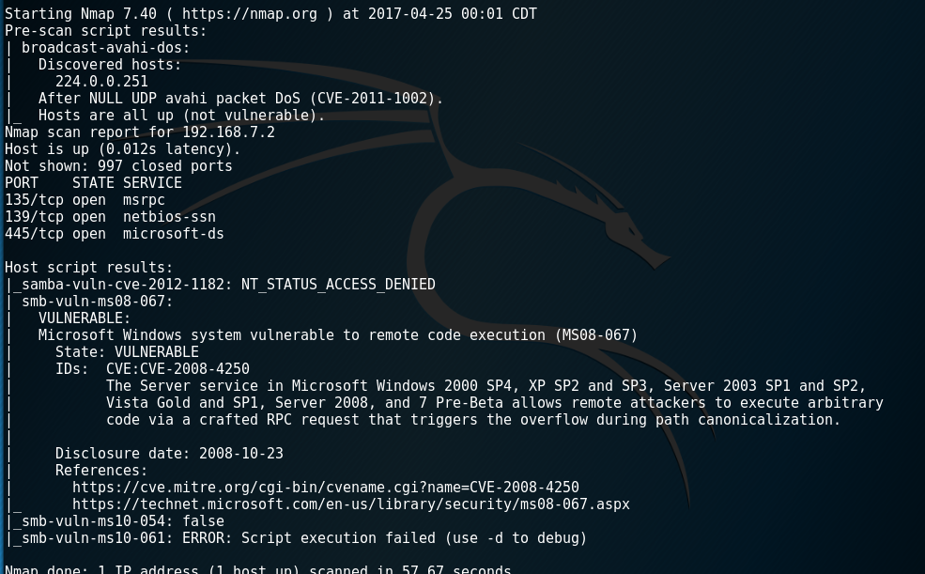

Slide 26
My Favorite NMAP Commands
nmap –script ssl-cert,ssl-enum-ciphers –p 443 [network range]
Scans the network range for SSL certificates and their associated ciphers.
Good for finding weak signing alogrithms
nmap –script=resolveall --script-args=newtargets, resolveall.hosts=example.com
Scans all IPs the hostname resolves to.
nmap –A –T4 –sV –iL [document.txt]
Will scan a document full of hosts and IP Addresses.
nmap –A –T4 –sV [ip address or subnet] –oN [document_name.txt]
Outputs nmap information into a document.
nmap –A –T4 –sV [ip address or subnet] –oX [document_name.xml[
Outputs nmap information into a XML document.
Notes:
Will show this in the demo

Slide 27
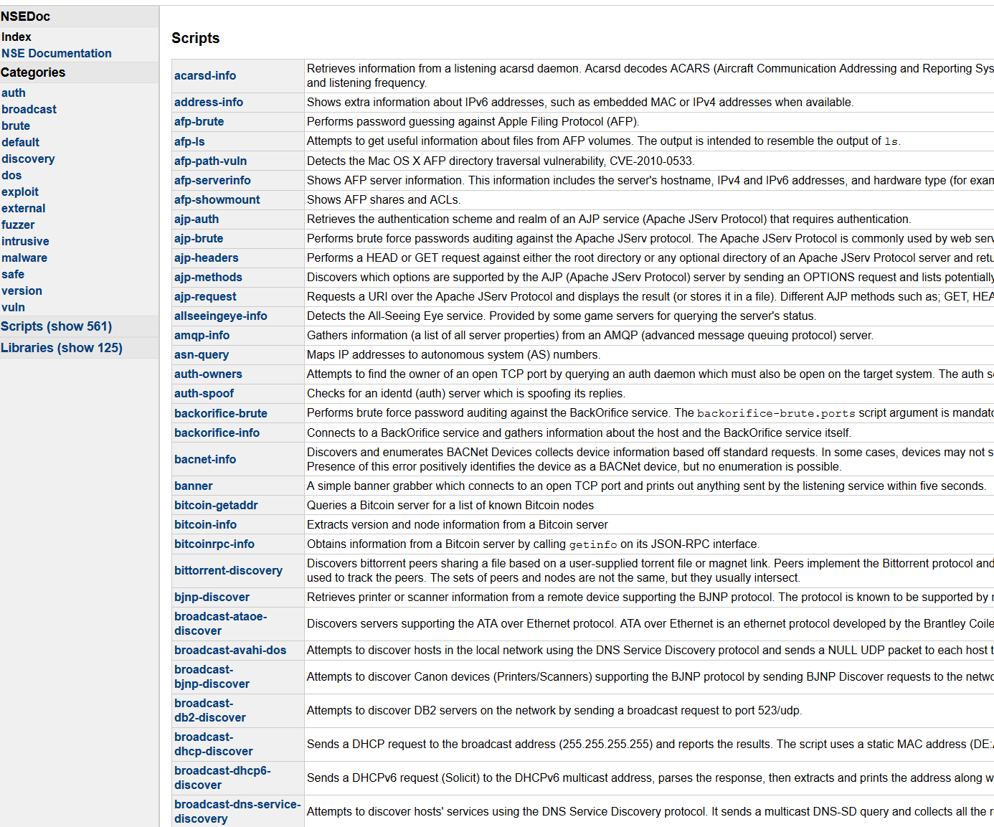
NMAP Scripting Engine

Slide 28
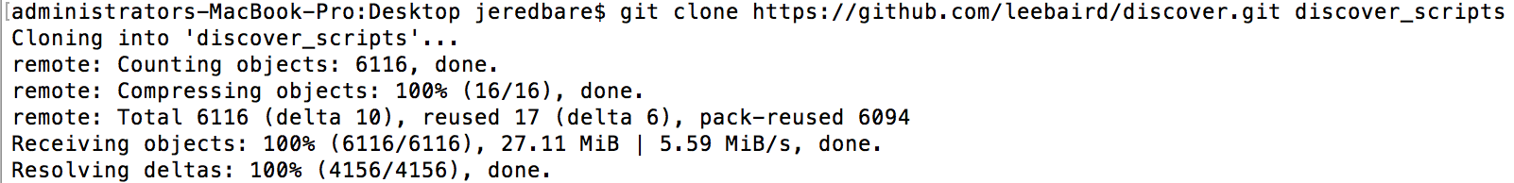
Passive Discovery Scripts

Slide 29
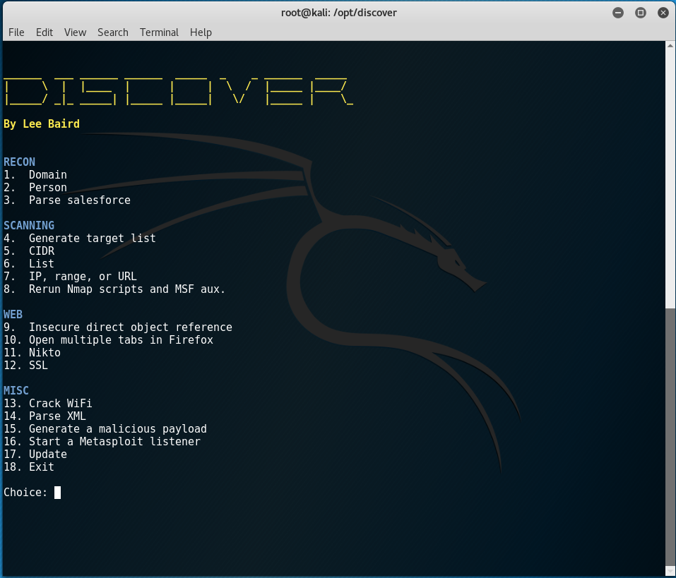

Slide 30
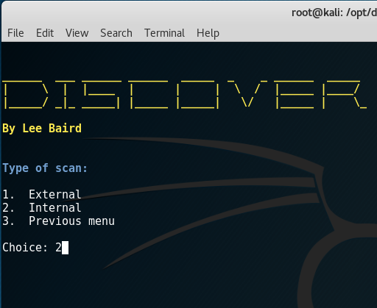

Slide 31
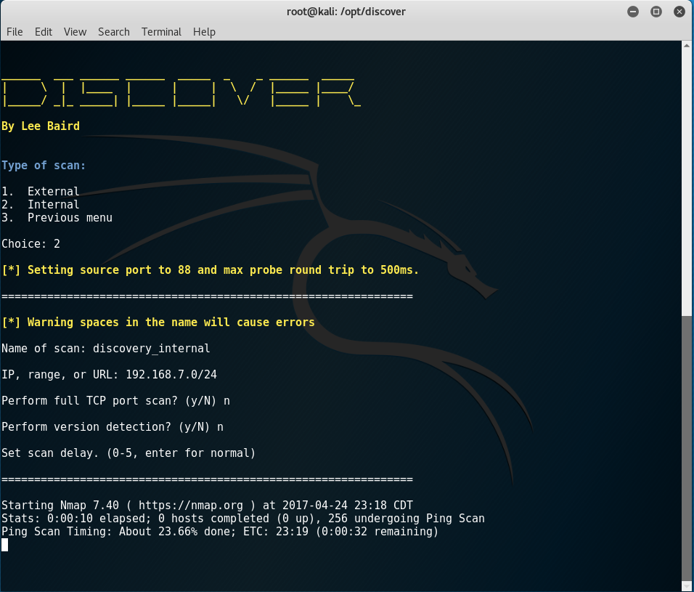

Slide 32
How - GUI
ZenMap
GUI interface to nmap.
Can run all the same commands as you would from the command line.
Sparta
Network, port and vulnerability scanner.
Included in Kali Linux
Be careful with this tool!
Wireshark
Network protocol analyzer.
Can see what is exactly going on in your network.
Universal Platform: Windows, Mac OSX, Linux.
https://www.wireshark.org/

Slide 33
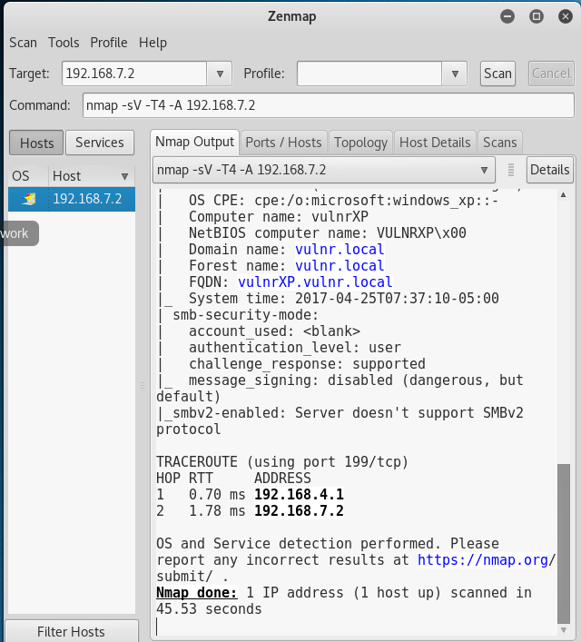
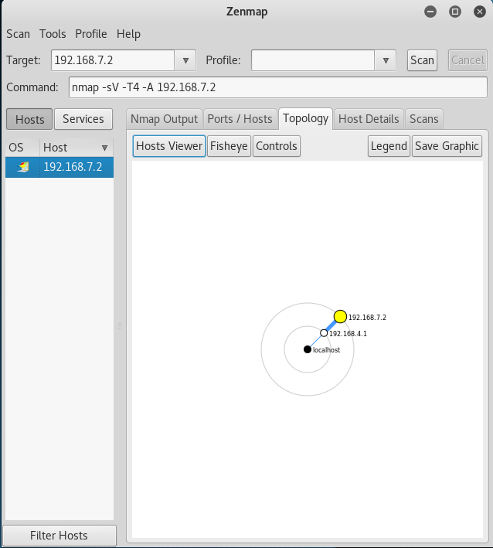

Slide 34
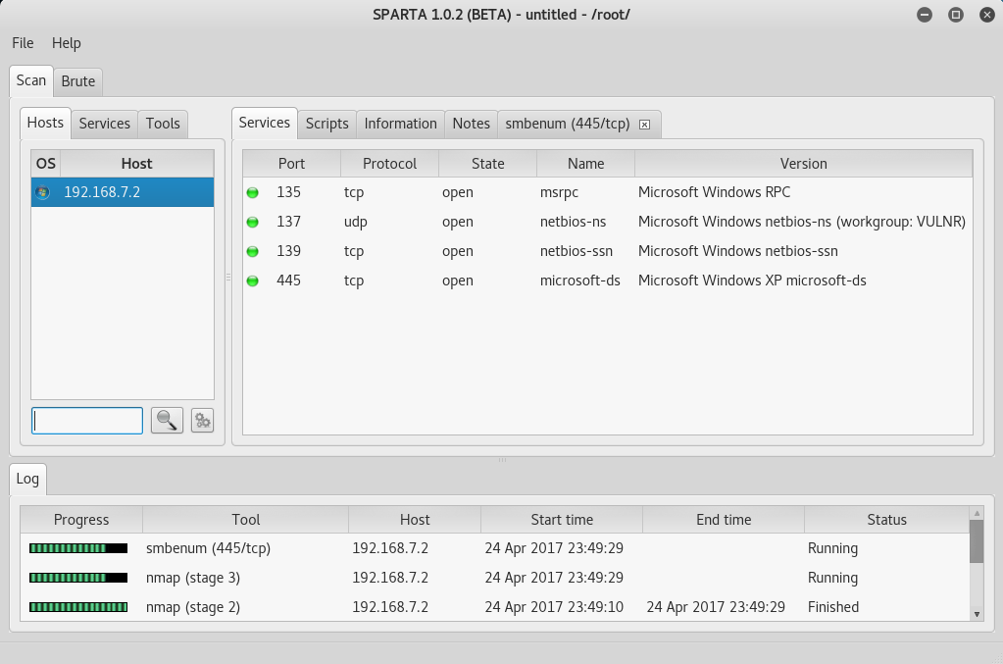

Slide 35
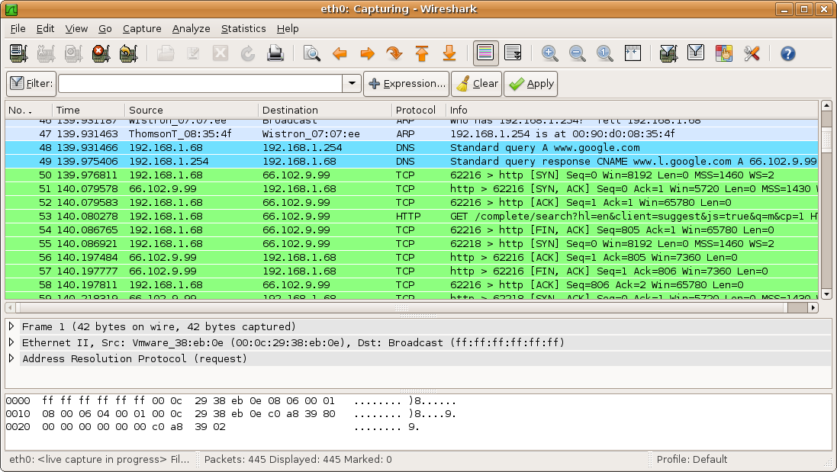

Slide 36
How – Web Based/API
Censys.io
Search Engine that allows to search for open devices and to see how they are configured. Shows various technologies open to the internet.
Shodan
Search Engine that crawls the internet for open devices.
IP Cams, Virtualization Servers, Home servers.
Certificate Logging Tools
Tool to find SSL certificates associated with your organization
Easy to use and setup.

Slide 37
How – Advanced - External
Warberry Pi
Penetration testing tool suite on a Raspberry Pi
As soon as you plug in the device it will start running scripts.
Will monitor network activity, IP addresses, and MAC addresses.
https://github.com/secgroundzero/warberry/wiki
RainMap
Web application that allows users to launch Nmap scans from their browser.
Easy to use and graphical interface.
https://github.com/cldrn/rainmap-lite
Automation/Scripting
Write your own tools and use the advanced features of NMAP.
All of these tools can be ran on a small Linux Server.
Cloud Scanning
DigitalOcean
Amazon AWS

Slide 38
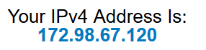
Censys.io and Shodan.io

Slide 39
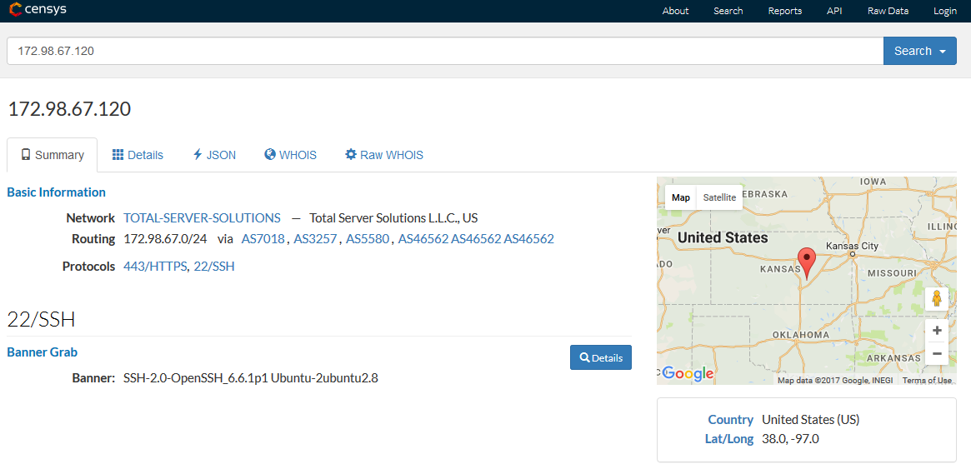

Slide 40
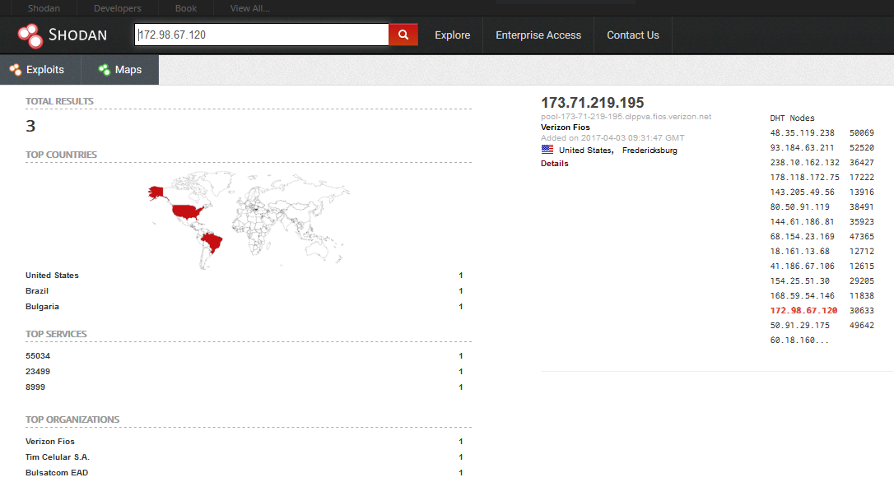

Slide 41
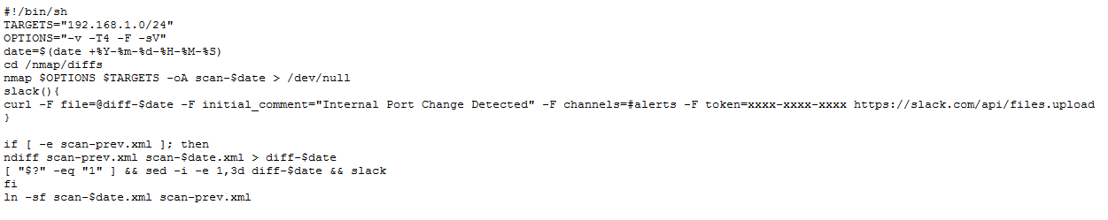
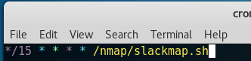
Automation/Scripting - Slackmap

Slide 42
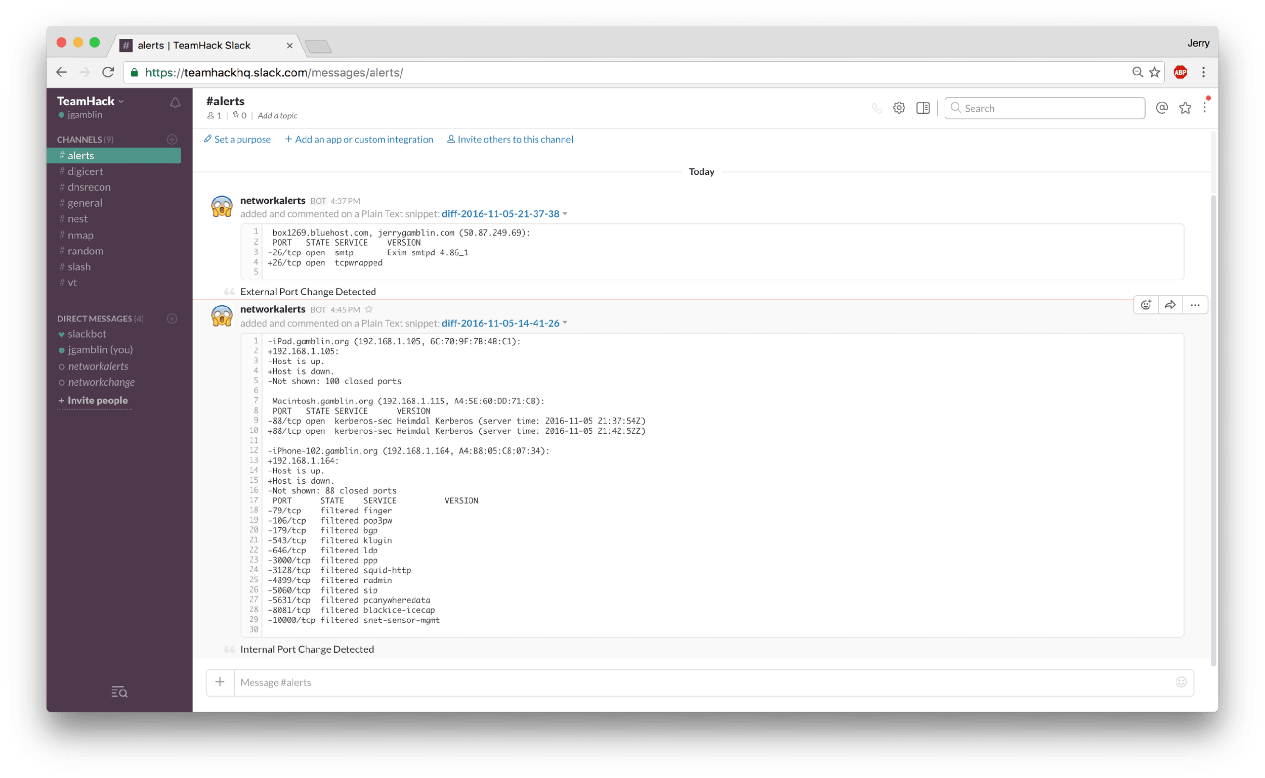
Slackmap

Slide 43
WannaCry :’’(
Remember WannaCry?
Ransomware attack released in May 2017. Affected all major Windows Operating Systems.
Utilized a SMB Flaw to run exploits.
So bad that Microsoft released patches for Windows XP and Server 2003
How can we utilize tools to alert what machines are vulnerable to WannaCry?
NMAP!!!

Slide 44
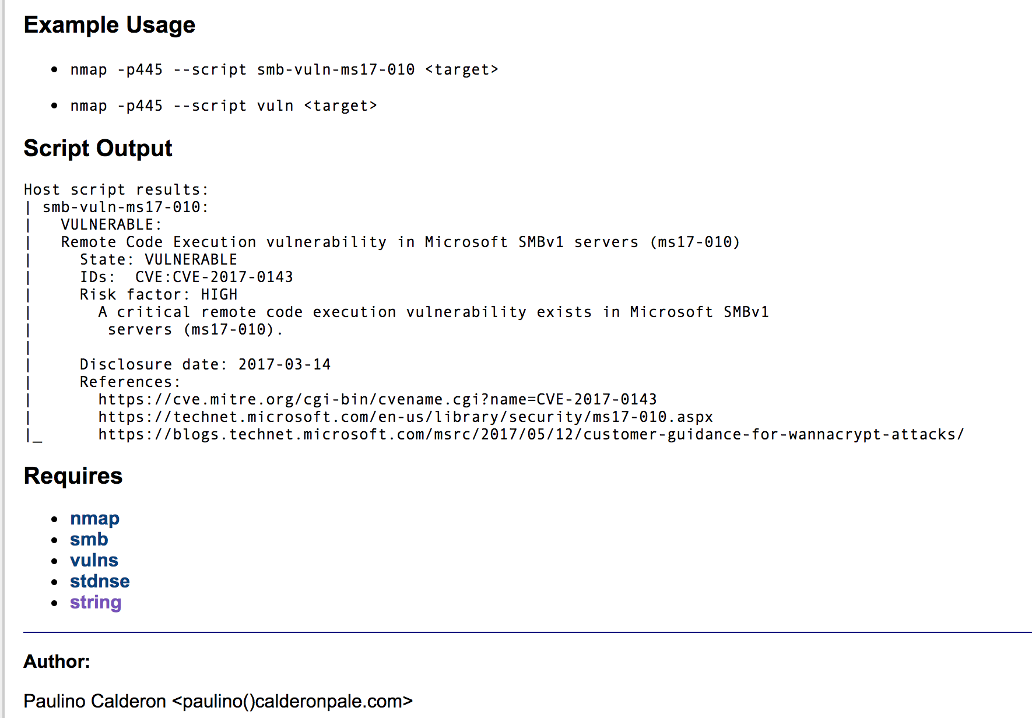
WannaCry :’’(
Remember WannaCry?
Ransomware attack released in May 2017. Affected all major Windows Operating Systems.
Utilized a SMB Flaw to run exploits.
So bad that Microsoft released patches for Windows XP and Server 2003
How can we utilize tools to alert what machines are vulnerable to WannaCry?
NMAP!!!

Slide 45
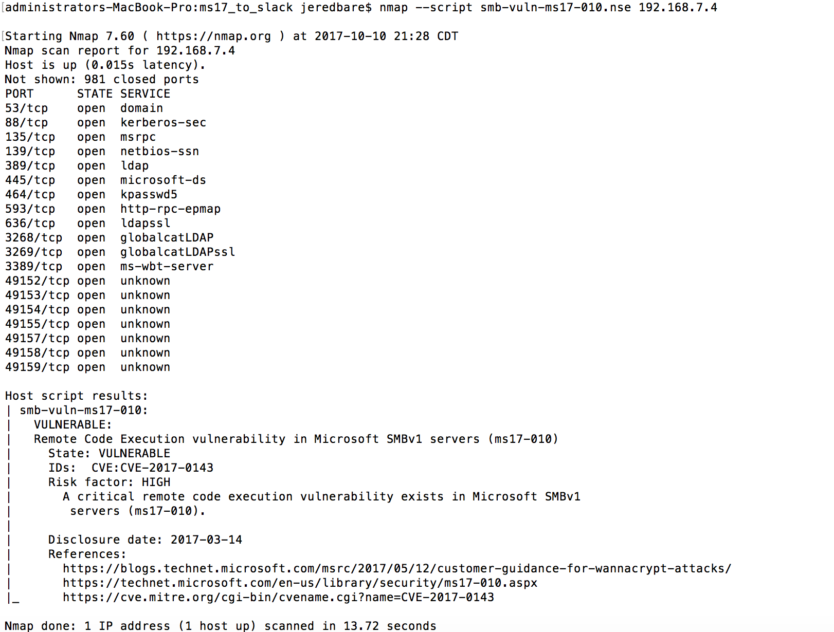

Slide 46
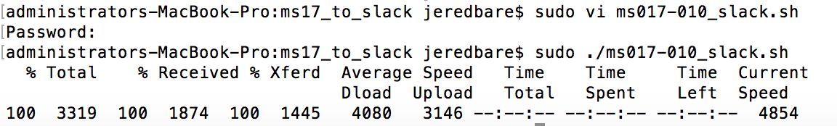
How can we alert for WannaCry?
Utilize the script written by Paulino Calderon and upload the results to Slack.

Slide 47
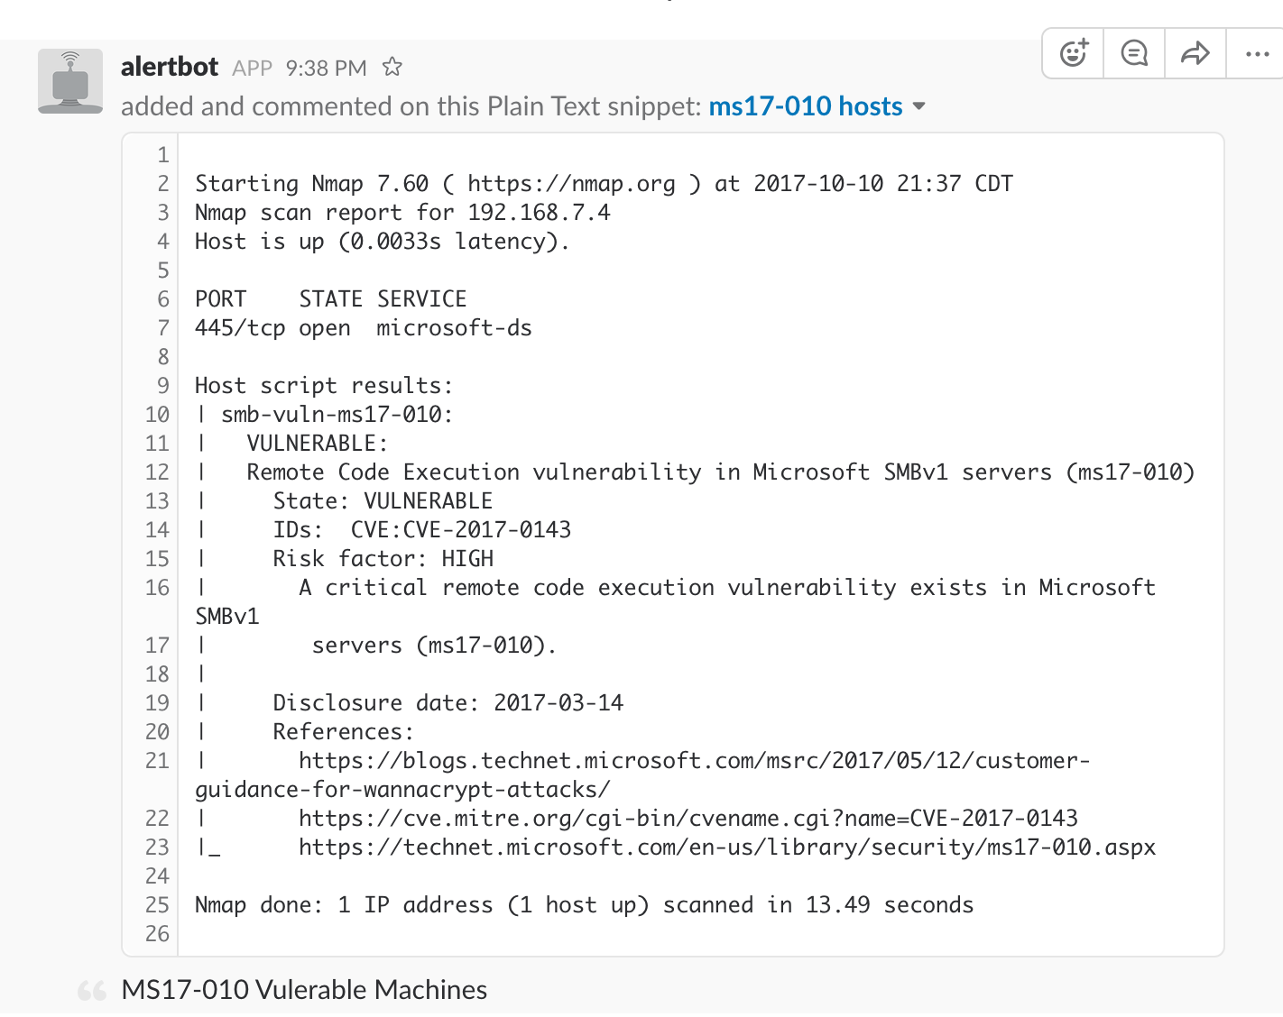

Slide 48
Certificate Logging Tools

Slide 49
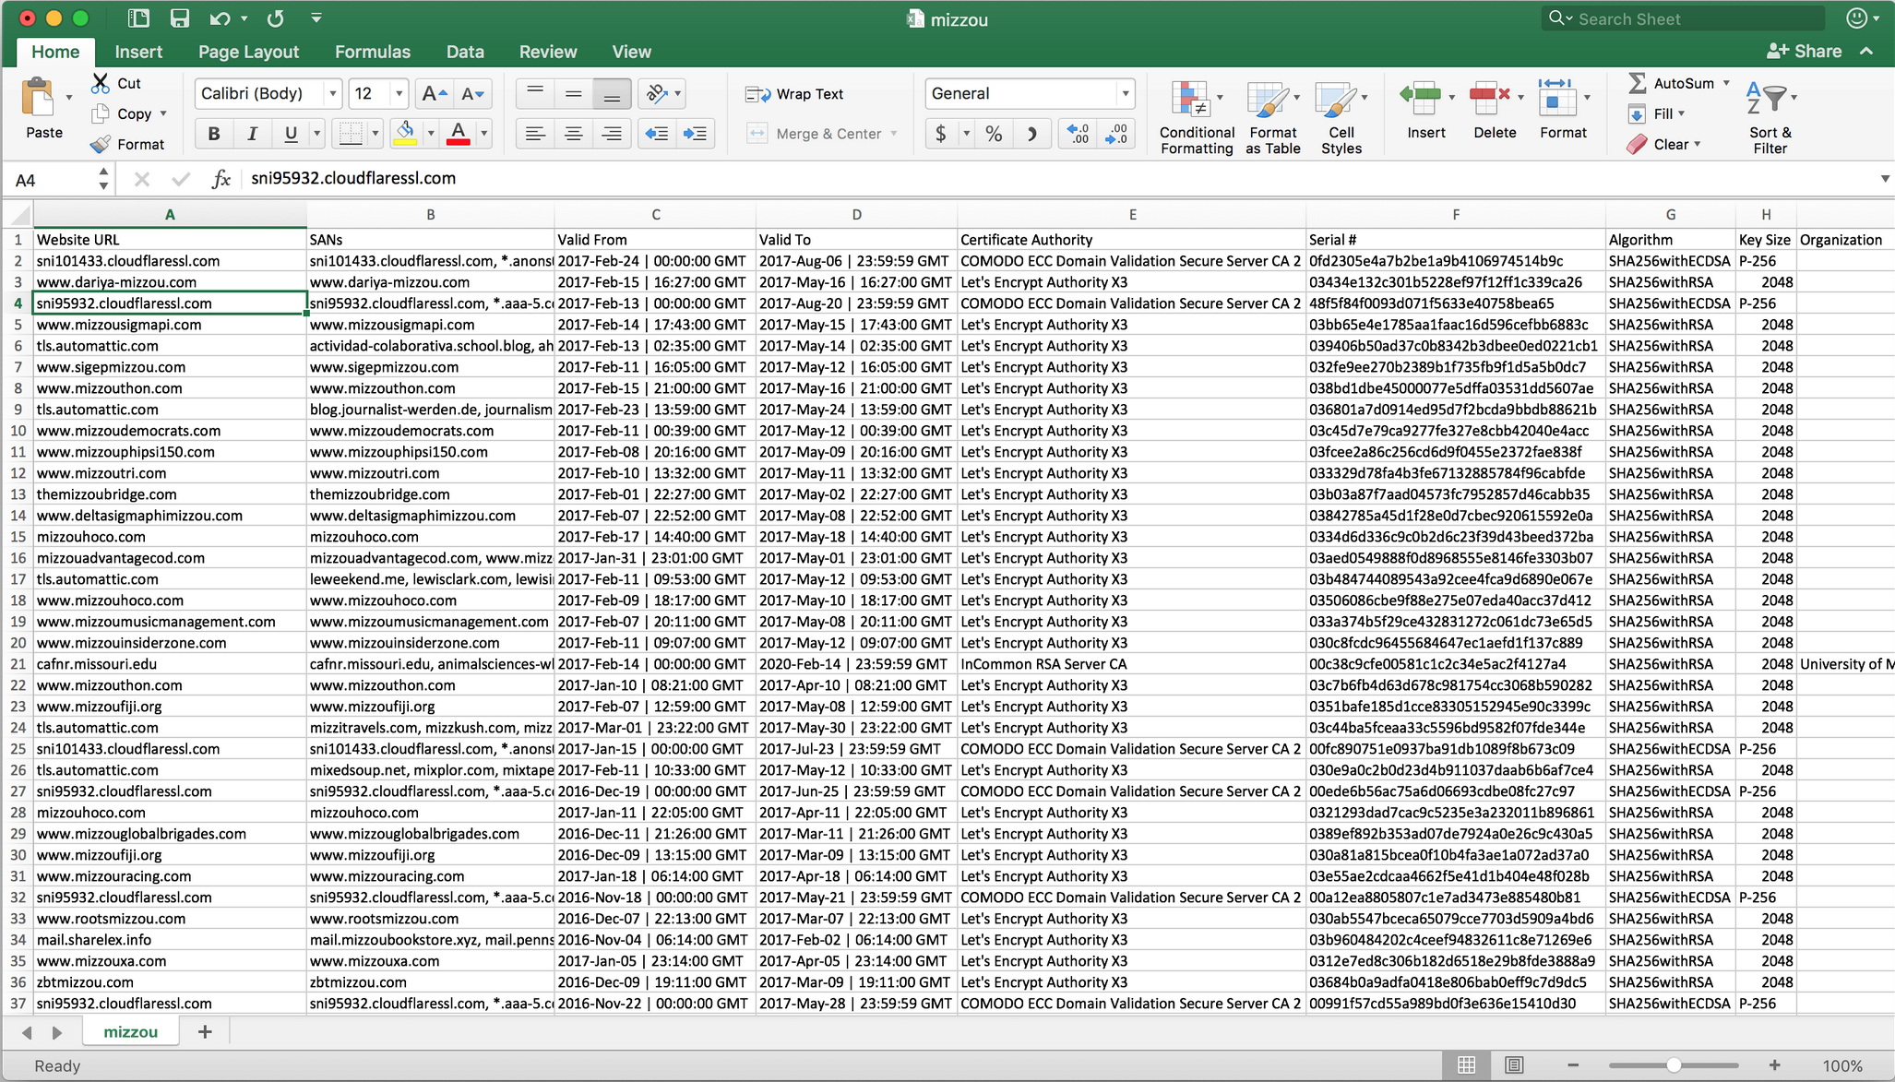

Slide 50
Failures and Challenges
Logging and Alerting
How exactly are you going to log these actions?
How are you going to alert for these actions?
Actionable vs Informational
If a port comes open and then closes, does that mean its an issue?
This stuff takes time
Will need some down time to learn and set all of this up.

Slide 51
Well...this is great and all; but how do I get started?

Slide 52
GET
Permission

Slide 53
May I….hack..I mean Port Scan our network?
From Your Boss/Their Boss/Their Boss and so on.
Get it in writing. CYA.
Assessment Scope.
Develop a document of what you are testing, what you are planning to do and who exactly to contact if issues happen.
Not a question of if, but when something breaks
Get sign off from the top.
Inform Departments of what you are doing.
Call and talk with your SysAdmins, HelpDesk, Developers, etc.

Slide 54
Options to Build Your Tools
Old Machine
Have an old machine? Use it strictly for a discovery box!
Dual Core Processor
4GB of RAM
Linux (Debian Preferred)
Gigabit network card
Cloud Options
These options usually have a request form for Scanning/Pen testing services externally.
DigitalOcean
Amazon
Heroku
Virtual Machine
Local or server.

Slide 55
Recap
Finding information on your network does not need to be hard or costly.
Utilize Open Source tools to your advantage.
Learn the tools and build better ones! Become apart of the community!

Slide 56


Slide 57
http://www.hackersforcharity.org/puerto-rico-relief-efforts/

Slide 58
Contact
Twitter: @jeredbare
Email: jeredbare@gmail.com
Cell: 573-355-0676
https://github.com/jeredbare/whopluggedthatin

Slide 59
Demo

